Slide 1
Session 2
Controls of WinForms

Slide 2
Review
Class libraries are the collection of reusable classes, or types.
Classes are the basis of all objects.
A class contains the characteristics and functionality that objects can possess. The characteristics and functionality are known as Properties and Methods respectively.
An Object is an instance of a class, which can be used to access the properties and methods defined in the class.
An Event is any action directed at the application.
The set of code that is executed in response to an event is called the Event Handler.
The capturing of events and execution of the event handler is called Event Handling.
All interactions between the user and the application take place through the user interface. A good user interface should be:
  Easy to learn
  Easy to use
  Attractive

Slide 3
Review Contd…
User interfaces can be of any of the following two types:
  Character Based Systems
  Graphical User Interface
The basic unit of the Windows applications created in WinForms is a Form.
Form objects can contain certain visual interface components that can be used for the interactions between the user and the application. These components are collectively known as Controls.
‘this’ keyword represents the currently active form in the C# language.
The Label control is used to display the text that cannot be edited by the user.
The TextBox control is used to accept input from the user or display text to the user.
An easy way to allow the user to interact with an application is by using the Button control.
The ListBox control is used to display long lists of options from which the user can choose.
The ComboBox control combines the features of the TextBox and the ListBox controls.

Slide 4
Objectives
Explain the different types of controls
Group controls according to their types
Work with more interface components
Call one form from another form

Slide 5
Controls
What is a control?
Each component
that is added
to a form
Example:
DataGrid
Button

Slide 6
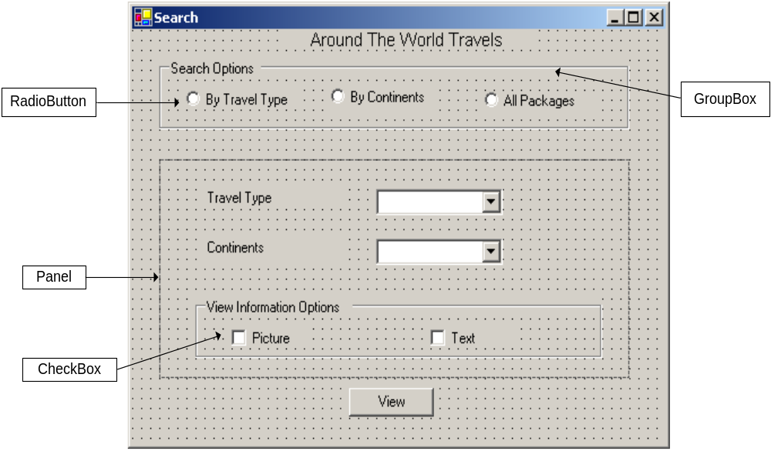
Some new Controls

Slide 7


Text Control
Text Edit
Text Display
TextBox
Label
LinkLabel
StatusBar

Slide 8
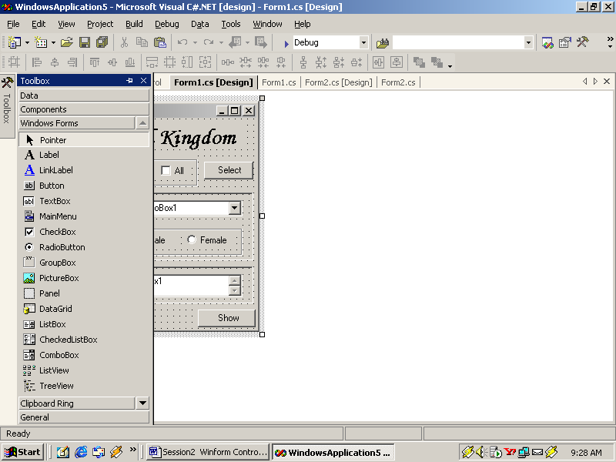
LinkLabel
LinkLabel
ActiveLinkColor
LinkArea
Properties
DisabledLinkColor
LinkBehaviour
Links
VisitedLinkColor
LinkColor
Events
LinkClicked

Slide 9
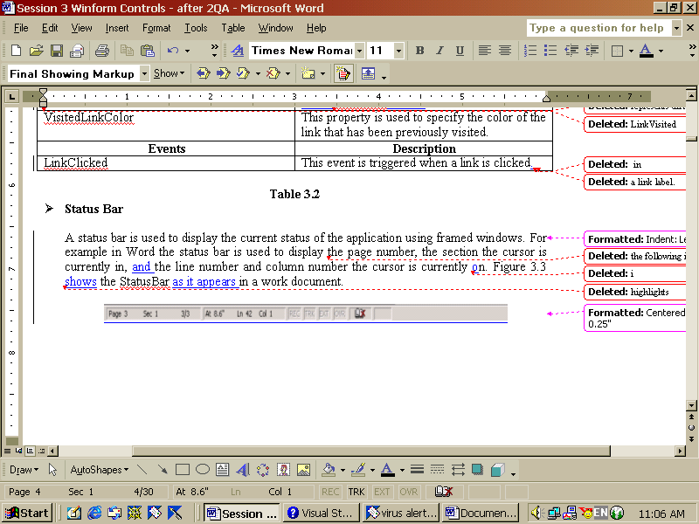
Status Bar
Is used to display the current status of the application using framed windows
A sample status bar from a word document

Slide 10


Command Control
User Interaction with the Application
ToolBar
Button
LinkLabel

Slide 11
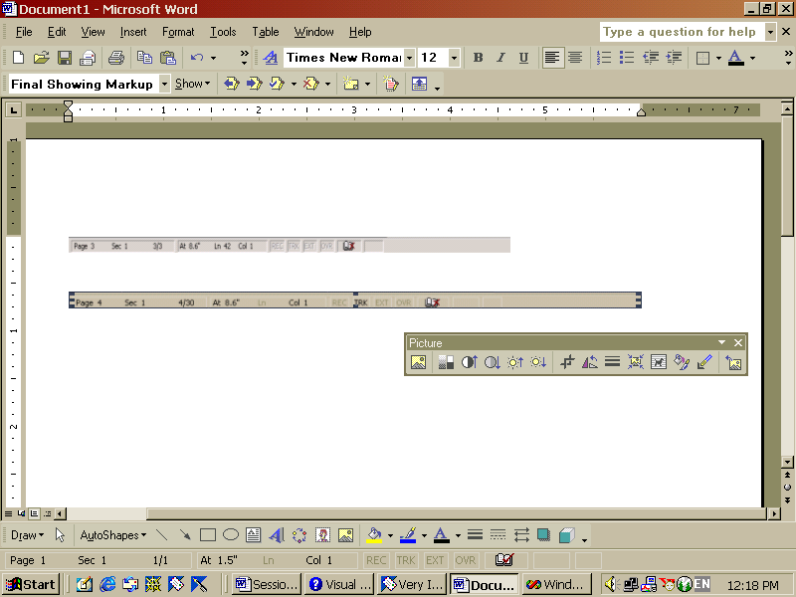
ToolBar control
Is a collection of buttons with different functionalities
Can be positioned as per the requirement
A sample toolbar from a word document

Slide 12
Selection List Controls
ListBox
ComboBox
CheckedListBox
ListView
TreeView
NumericUpDown
DomainUpDown

Slide 13
ListView control
List
The four view
types of
ListView control
Text with small icons
Text with large icons
Details

Slide 14
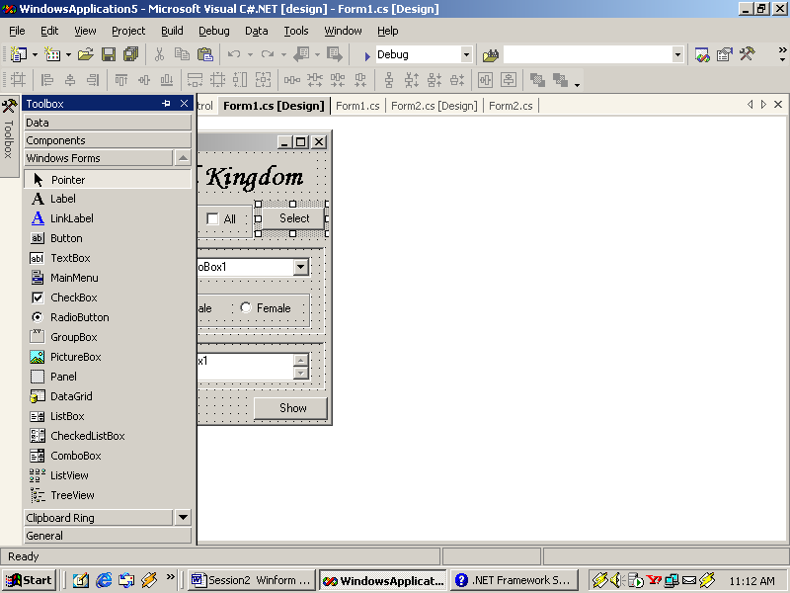
ListView control
Properties
Methods
ListView
GetItemAt
Sorting
Clear
View
Events
FullRowSelect
ColumnClick
MultiSelect
ItemCheck

Slide 15

TreeView control
Properties
ImageIndex
TreeView
SelectedNode
ShowPlusMinus
ShowRootLines
Methods
Events
ExpandAll
AfterCheck
AfterSelect
GetNodeAt
AfterCollapse
AfterExpand
GetNodeCount
BeforeCheck
BeforeSelect
CollapseAll
BeforeCollapse
BeforeExpand

Slide 16
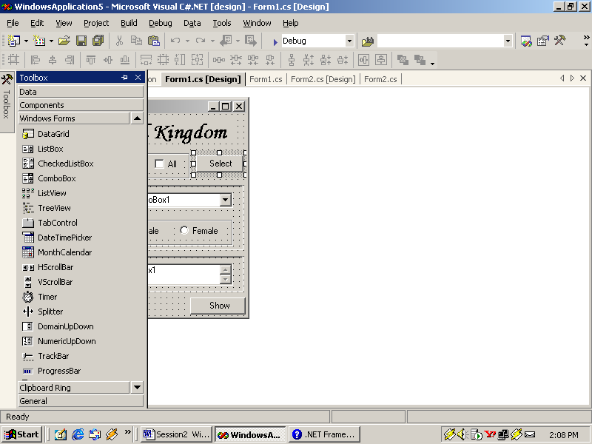
NumericUpDown
Properties
NumericUpDown
Increment
Maximum
Methods
Minimum
DownButton
Value
UpButton
Events
DecimalPlaces
ValueChanged

Slide 17
DomainUpDown
DomainUpDown
Methods
Properties
DownButton
SelectedItem
UpButton
Items
Wrap

Slide 18
Value Setting Controls
CheckBox
CheckedListBox
RadioButton
TrackBar

Slide 19
CheckBox
CheckBox
Properties
Appearance
Events
ThreeState
AppearenceChanged
Checked
CheckedChanged

Slide 20
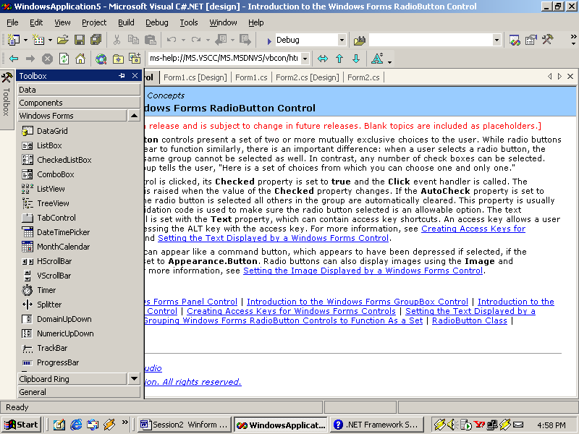
TrackBar
Properties
TrackBar
TickStyle
Minimum
Value
Maximum
SmallChange
TickFrequency
LargeChange
Methods
Events
SetRange
ValueChanged
Scroll

Slide 21
Grouping Controls
Form
Panel
GroupBox
Tab Control

Slide 22
Form, Panel, GroupBox
Properties
Events
Enabled
Methods
Enter
Size
Focus
Leave
Visible
Refresh
Paint

Slide 23
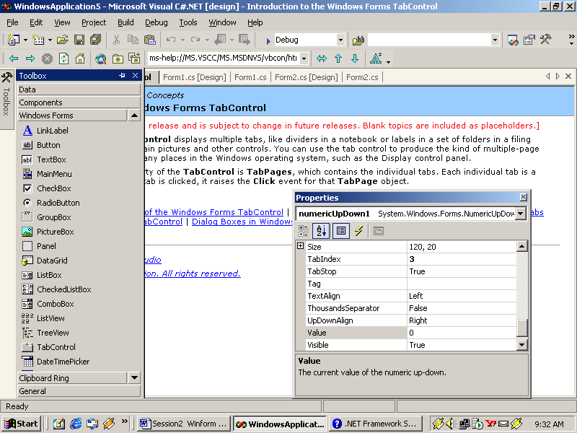
TabControl
TabControl
Properties
TabCount
SelectedTab
TabPages
ShowTooltips
Events
SelectedIndex
Multiline
SelectedIndexChanged

Slide 24
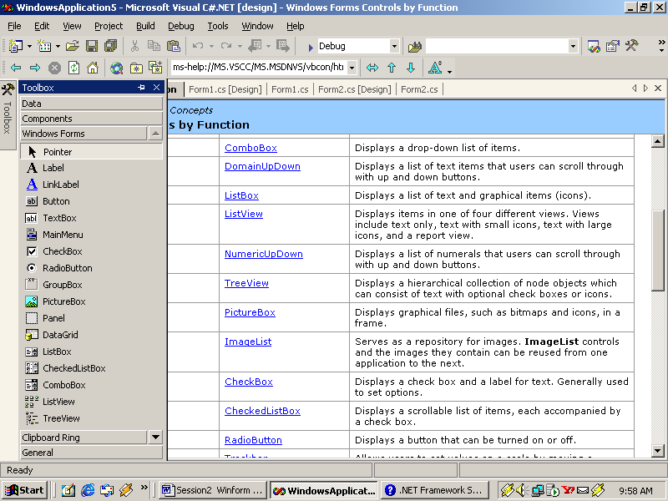
Graphics Display Type Controls
PictureBox
Properties
Events
Image
SizeModeChanged
SizeMode

Slide 25
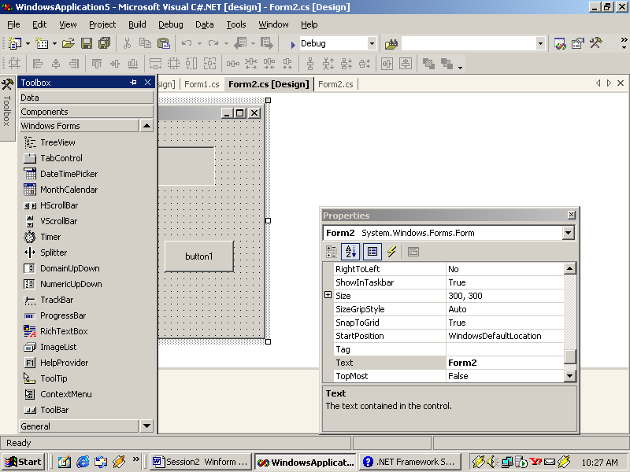
Graphics Storage Type Controls
Properties
ImageList
ImageSize
Methods
Images
Draw

Slide 26
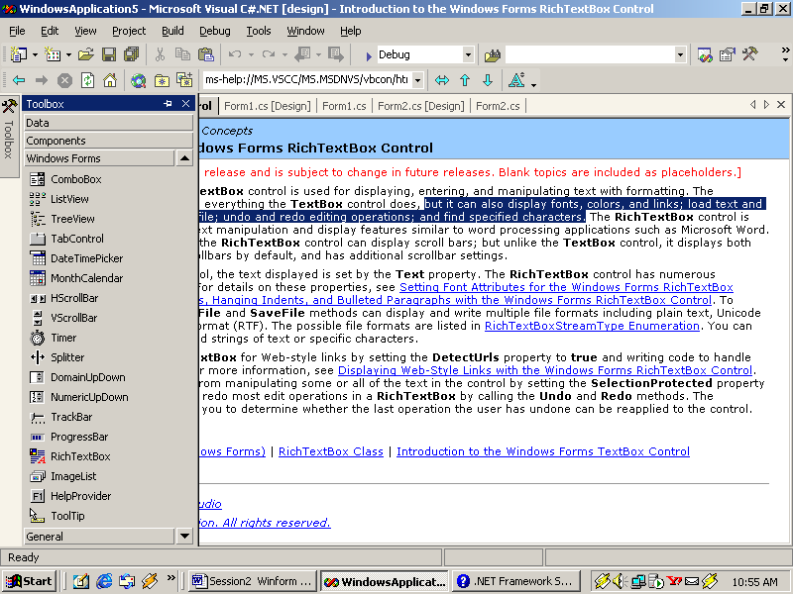
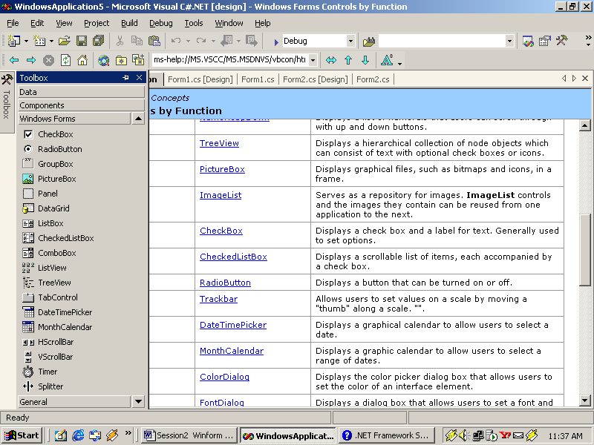
RichText controls
RichTextBox
DateTimePicker
MonthCalender

Slide 27
RichTextBox
RedoActionName
SelectionFont
Properties
SelectionColor
ZoomFactor
UndoActionName
SelectedText
DetectUrls
Methods
Events
GetCharFromPosition
LinkClicked
LoadFile
Find
SelectionChanged
Redo
SaveFile

Slide 28
DateTimePicker and MonthCalender controls
DateTimePicker
MonthCalender
Displays graphical Calender
Allowing users to select the
desired date
Allows selection
of a range of dates

Slide 29
Advanced Controls
Timer
Scrollbar
ProgressBars
ToolTip

Slide 30
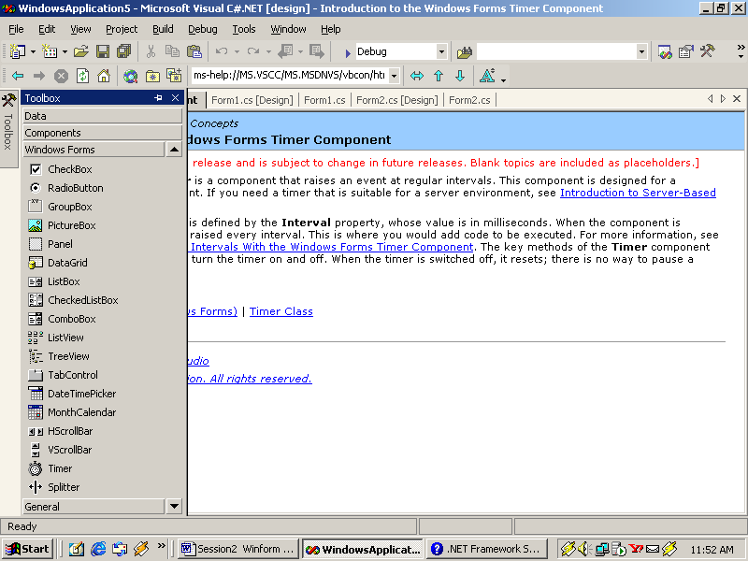
Timer
Timer
Methods
Properties
Start
Enabled
Stop
Events
Interval
Tick

Slide 31
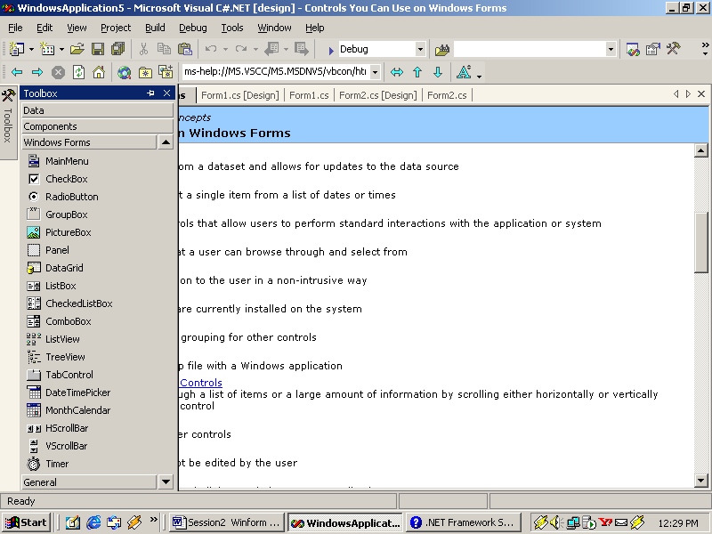
ScrollBar controls
HScrollBar and VScrollBar
Properties
SmallChange
Value
Events
LargeChange
Scroll
ValueChanged

Slide 32
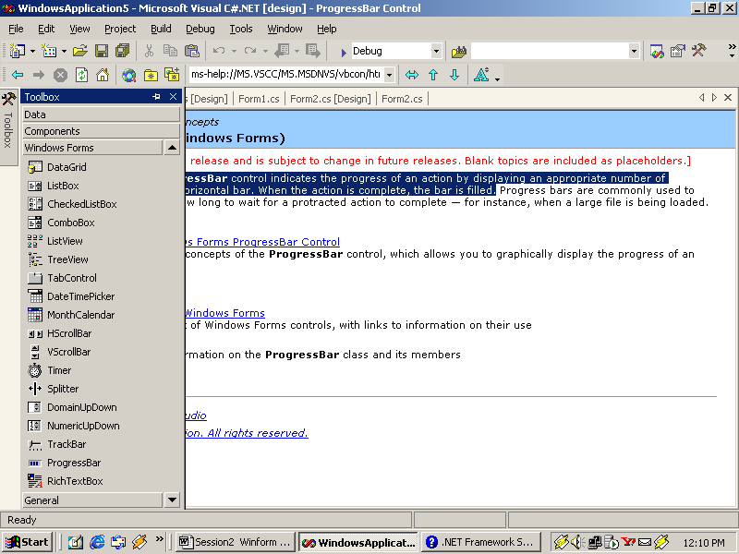
ProgressBar
ProgressBar
Properties
Step
Events
Maximum
PerformStep
Minimum
Increment
Value

Slide 33
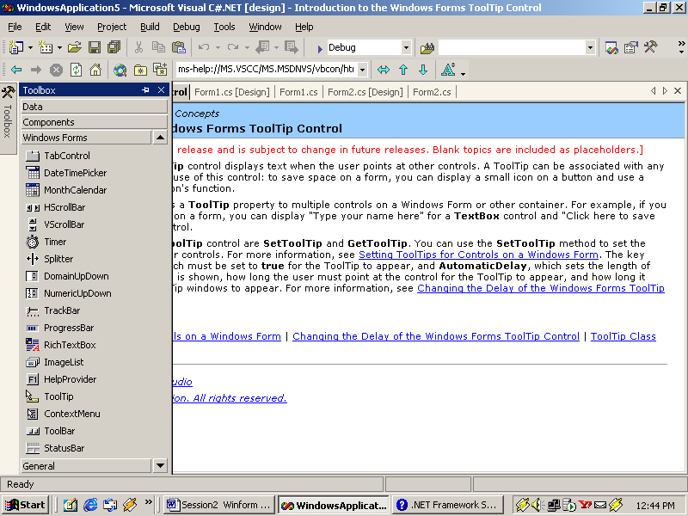
ToolTip
ToolTip
Properties
Events
GetToolTip
InitialDelay
AutomaticDelay
SetToolTip
ShowAlways
RemoveAll

Slide 34
Establishing link between forms
Create an instance of the form to be called
Show the instance
[calledform] [forminstance] = new [calledform]();
[forminstance].Show();
Example:
Search NewForm = new Search();
NewForm.Show();

Slide 35
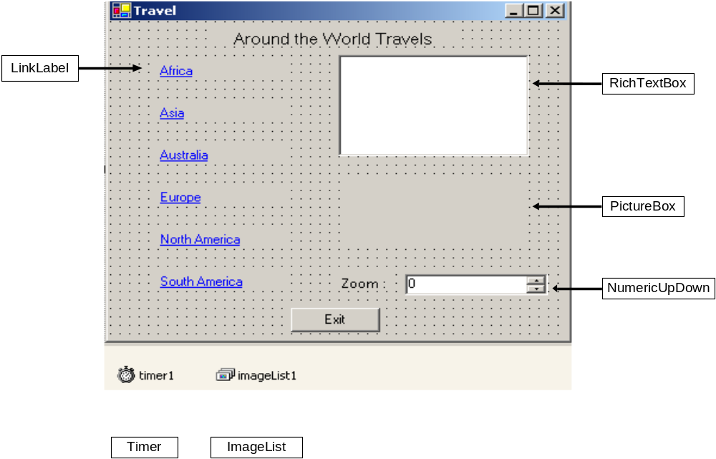
Sample Application

Slide 36
Summary
Different Controls are grouped into different types depending on the functionality they offer.
Text Edit Controls allow users to enter and edit text while Text Display Controls only display text to the user.
Selection list Controls display a set of values to the user and allow users to select a value from the list.
Graphic storage Controls store graphics, such as images, in it and Graphic Display Controls are used to display graphics, such as images.
RichText Controls are text controls that are enriched with extra functionality that differentiate them from other text controls

Slide 37
Summary Contd…
Value Setting Controls help users to set values, such as ‘yes’ or ‘no’.
Dialog Boxes Controls provide basic functionality like the Save dialog box, Open dialog box and Print dialog box.
Menu Controls provide the menu functionality to the user while Commands controls allow users to interact with the application.
A set of controls can be grouped using Grouping Controls. The steps involved in calling a form from another form are:
  Create an instance of the form to be called
  Show the instance

